Slide 1
Need Finding
Presented by John Paul C. Villanueva and Raymond Anthony A. Villaflores II

Slide 2
Review: user needs
Previous Needs
Bus to be available on Bus Stop
Free Seating
Arrival Time
Present Needs
Free-seating
Available Bus
Location of Bus to adjust accordingly (Bus GPS, Live Tracking)
Arrival time of Bus

Slide 3
Review: Point of view
Previous:
Time eats away as we wait for the bus, better go and do something else while waiting.
Arriving on a bus stop as the bus waits leads to comfortable ride.
Early to arrive takes away time, but arriving on time makes good use of time.
Present:
Availability is necessary
Standing gets you going, but Free-seating is relaxing

Slide 4
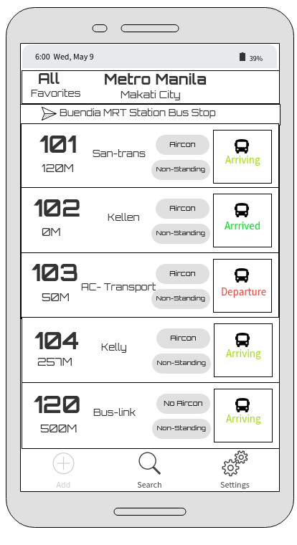
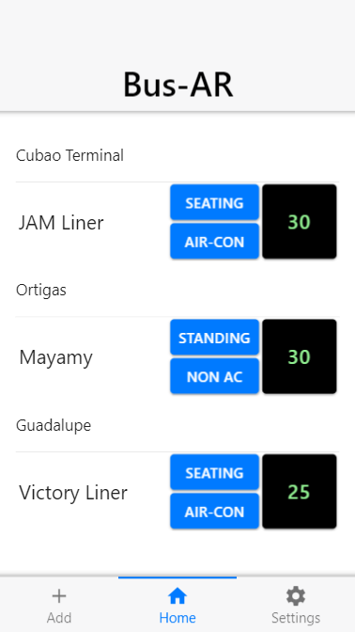
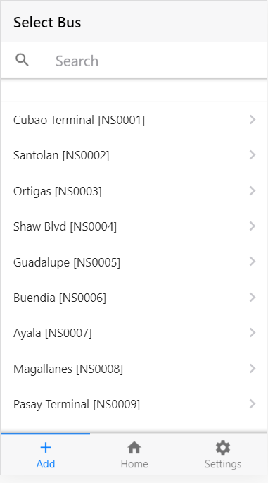
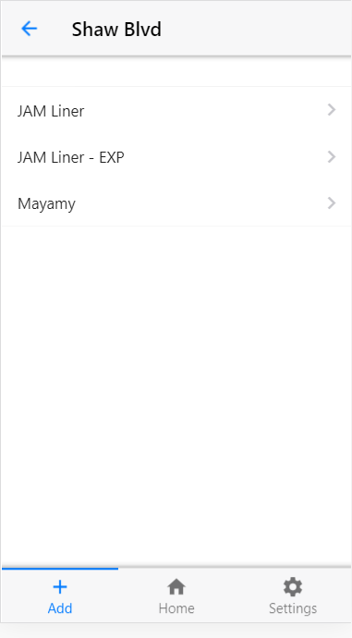
Wireframes & Screens

